Slide 1


SUPERVISED CONTRASTIVE LOSS
STATE OF THE ART
Powered by : Presented by :
Anant Kumar Jaiswal
Machine Learning Engineer at Intozi

Slide 2
AGENDA :
What is image classification?
What is cross-entropy loss?
What is contrastive loss?
Supervised contrastive loss :
a. What is supervised contrastive loss?
b. Method to implement it.
c. Why is it better than cross-entropy?
d. Properties.

Slide 3
IMAGE CLASSIFICATION

Slide 4
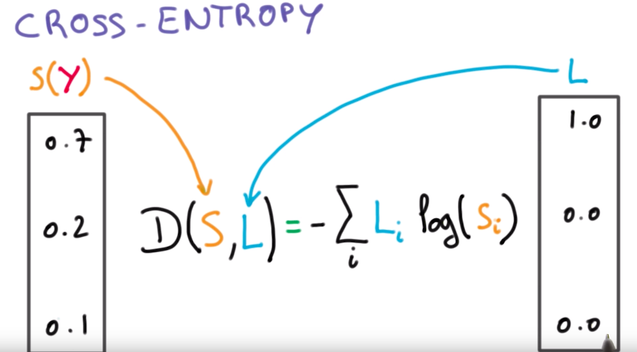
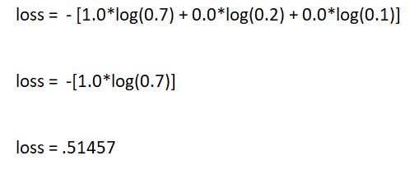
CROSS-ENTROPY LOSS
Loss function : The objective function to be minimized is called loss function and the value calculated by this function is called loss.
Cross-entropy loss : Minimizes the difference between the predicted probabilities distribution of a given dataset and the probability distribution of training set.

Slide 5
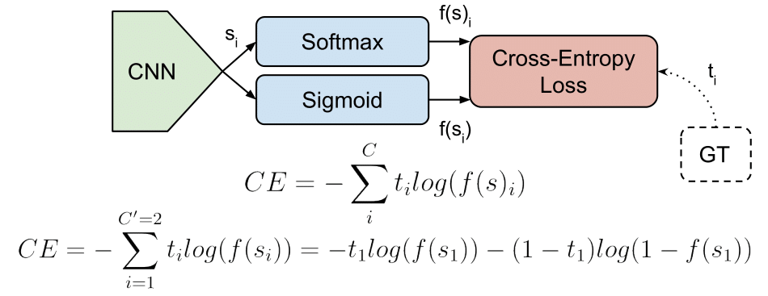
Binary cross entropy
No. of classes : 2
Labels : 0 or 1.
Categorical cross entropy
No. of classes : More than 2.
Labels : one hot encoded.

Slide 6
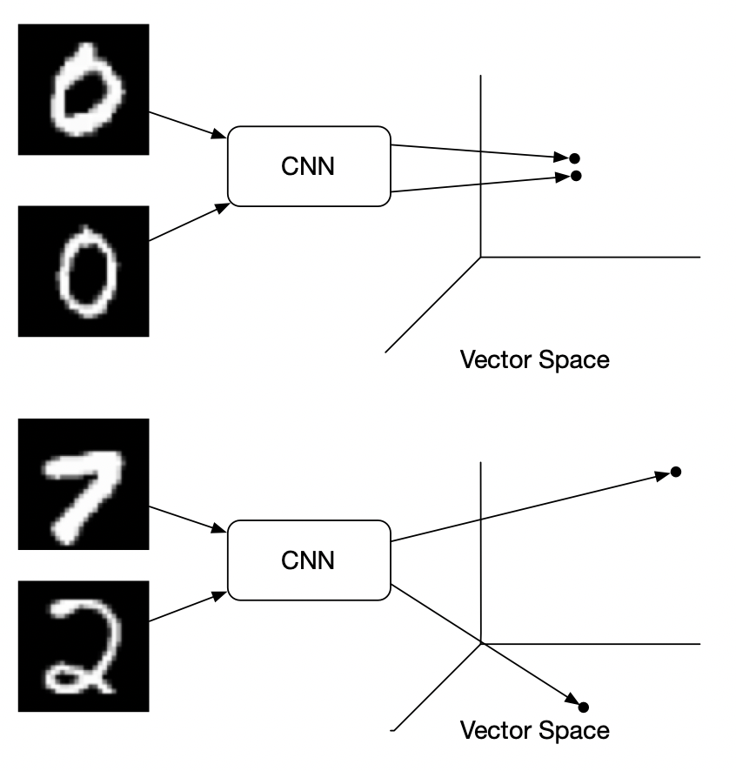
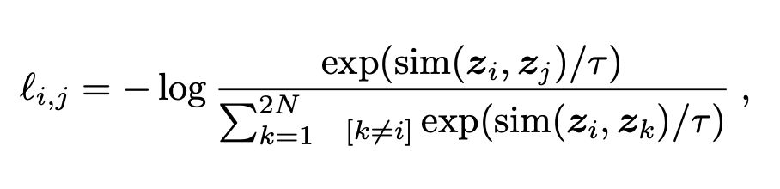
CONTRASTIVE LOSS
Unsupervised learning.
Bring together same class data.
Loss function :
sim : cosine distance
T : Temperature factor

Slide 7
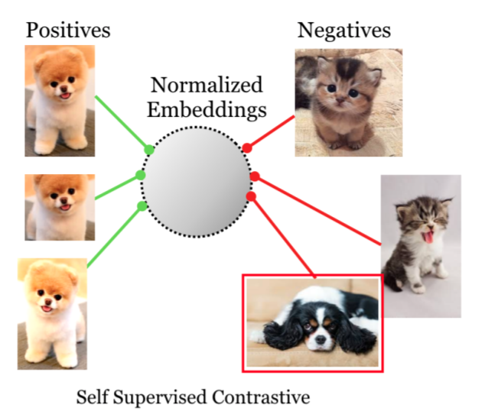
SUPERVISED CONTRASTIVE LOSS
Self supervised constrastive :

Slide 8
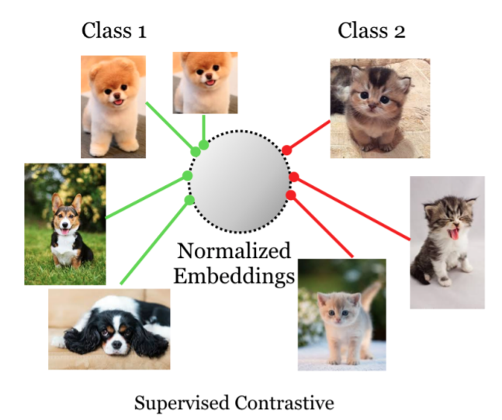
Supervised contrastive

Slide 9
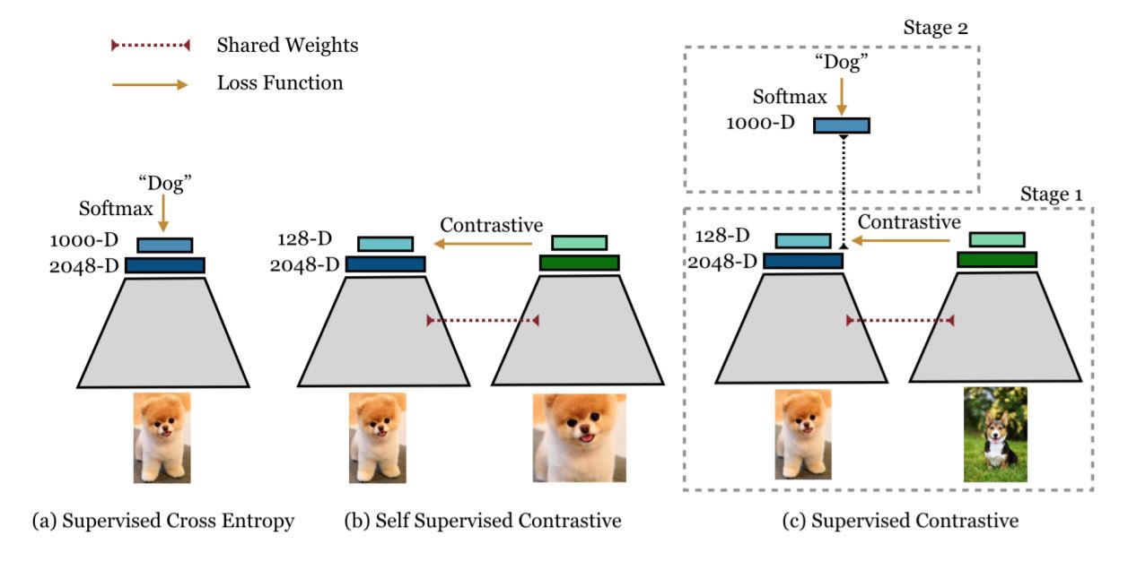
COMPARISON

Slide 10
IMPLEMENTATION
1. Data Augmentation :
- Each input image is transformed into two augmented images.
2. Encoder Network :
- Maps the augmented image to representation vector ‘r’.
- Representation layer is normalized.
3. Projection Network :
- Maps the encoder’s normalized representation vector to another vector ‘z’.
- Uses multilayer perceptron with single hidden layer.
- Only used in training supervised contrastive loss.

Slide 11
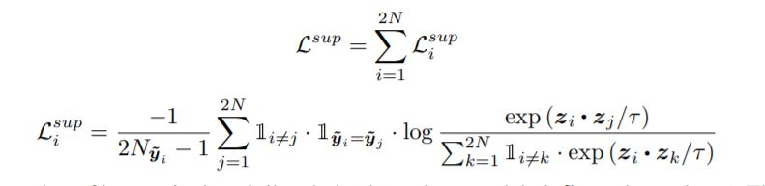
Loss Function
Generalization to an arbitrary number of positives.
Contrastive power increases with more negatives
Triplet loss is special case of supervised contrastive loss.

Slide 12
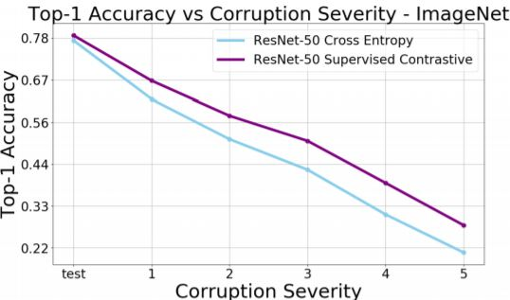
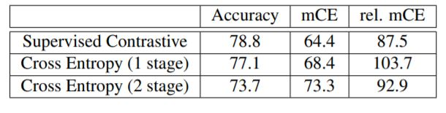
Why better than cross-entropy?
More Robust
Better representation learning

Slide 13
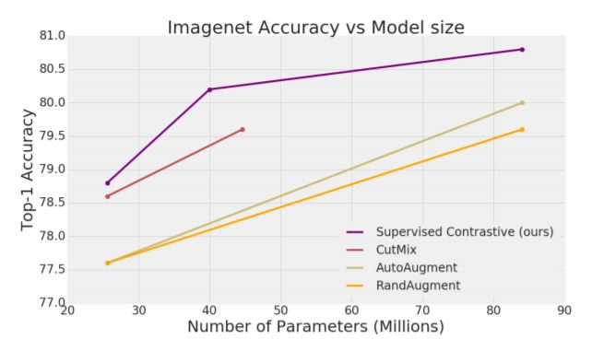
PROPERTIES
Smoothness
Hard Negatives
Robust
Hyperparamter Stability
State of the art.

Slide 14
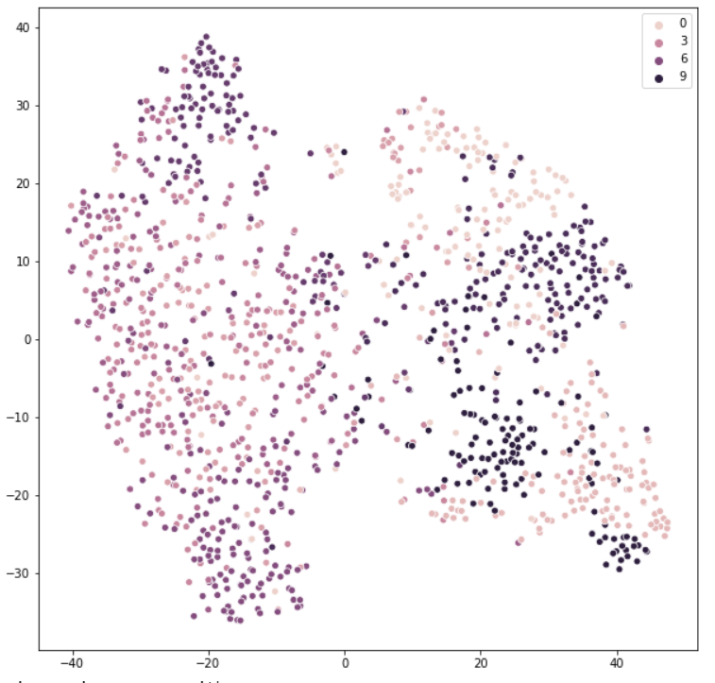
MY IMPLEMENTATION
Dataset : CIFAR10
Cross-entropy

Slide 15
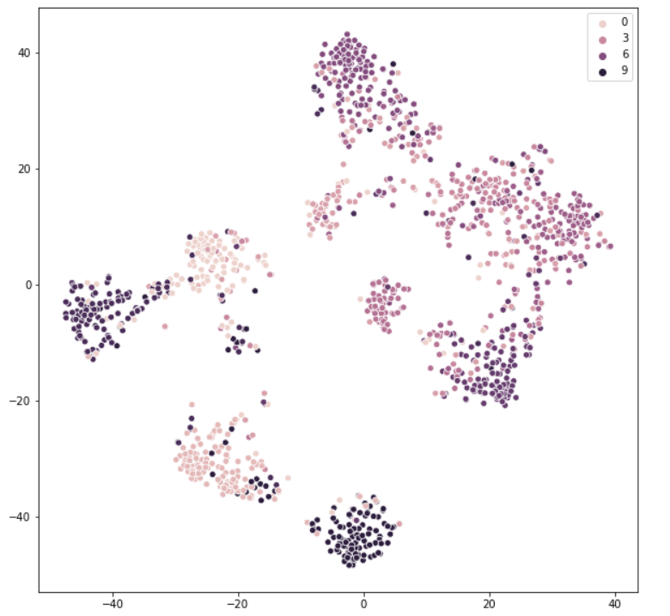
Supervised contrastive loss

Slide 16
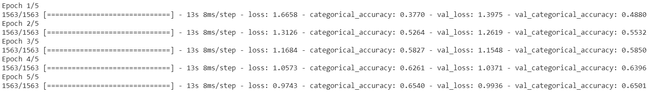
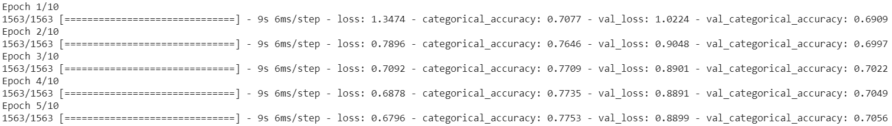
EPOCH VS ACCURACY :
Cross-entropy
Cross entropy after supervised contrastive training

Slide 17
THANKYOU.

